Slide 1
Stretching the Boundaries: Hunting for Elasticsearch Leaks
Viktor Markopoulos

Slide 2
About
Viktor Markopoulos (@vict0ni)
Pentester for 3+ years @ Bitcrack Cybersecurity
Bug bounty hunter @ various platforms, and self-hosted programs
Focusing on web applications, APIs, cloud

Slide 3
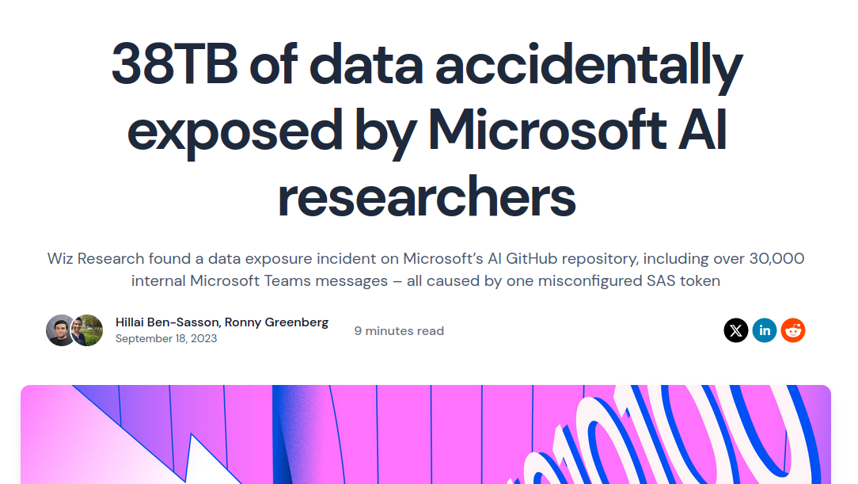
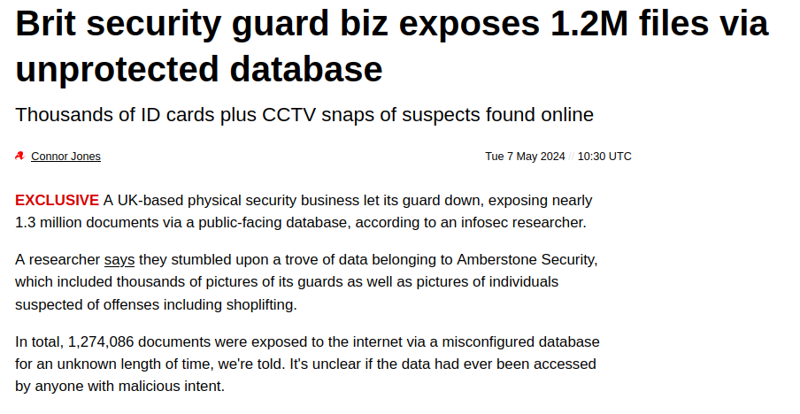
Leaks and juicy stuff on the Internet
Sensitive data released to an environment where they are not meant to be
Leaks in every technology
APIs, unauthenticated storage hosts, exposed files
Focus on unauthenticated storage hosts
MySQL, MongoDB, Elasticsearch, Redis, etc.
Usually a human error

Slide 4
Elasticsearch
Part of the ELK Stack
From collections to visualization
Data storage for analytics
Usually for traffic and system logs
“Usually”…

Slide 5
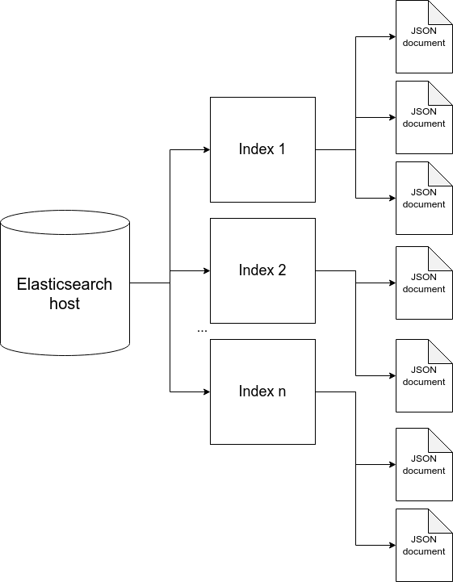
Elasticsearch
RESTful API to interact with
DBMS analogy
Index → Database
Types → Tables
Documents → Rows
Document fields → Columns

Slide 6
So, what’s the problem?
“Solution”
Use of Elasticsearch as a usual DBMS
Not really a problem on its own
Unauthenticated Elasticsearch hosts
Always a problem, like in DBMS’
Storing sensitive information without any encryption
PII, credentials, HTTP traffic secrets
Vulnerable host identification tool
Utilization of search engines
Analysis
Index, content
Leak and secret reveal

Slide 7
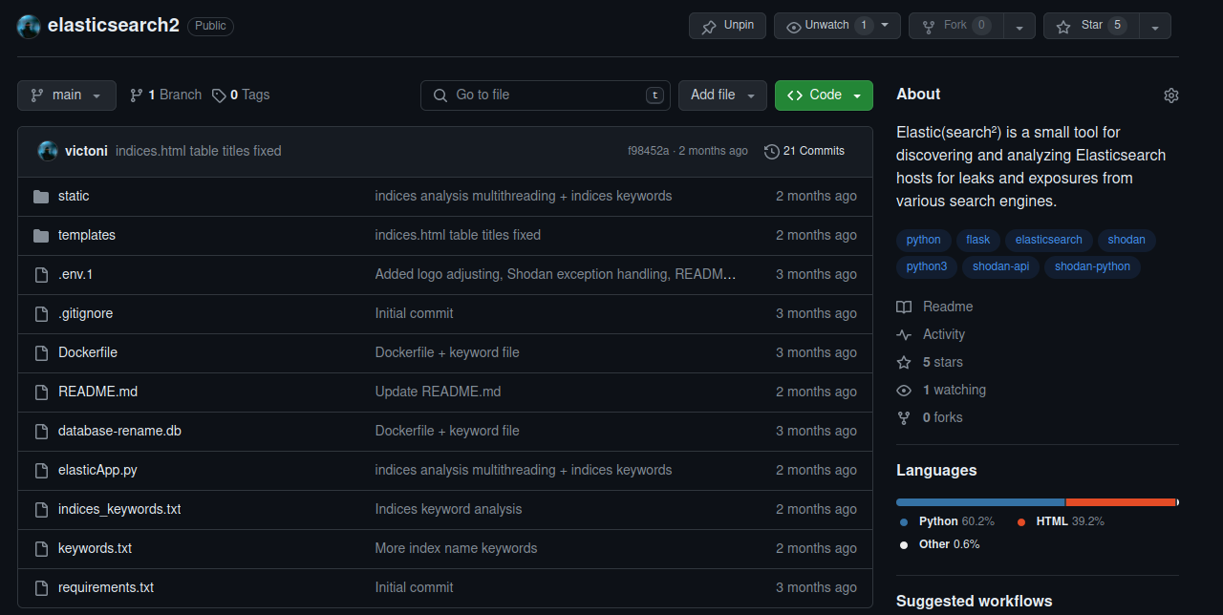
Elastic(search²)
Elastic(search²) is a small tool for discovering and analyzing Elasticsearch hosts for leaks and exposures from various search engines.

Slide 8
Elastic(search²)
Why?
I like exploring the Internet and finding leaks
Leaks are non-technical bugs / human error
Eternal struggle
Features
Textual analysis of indices and documents.
SQLite3 database for keeping track of already-reviewed hosts.
Cleanup function to get rid of secured hosts.
It currently looks only for hosts that contain GB of data. But this can of course be tweaked.

Slide 9
Elastic(search²)

Slide 10
Demo

Slide 11
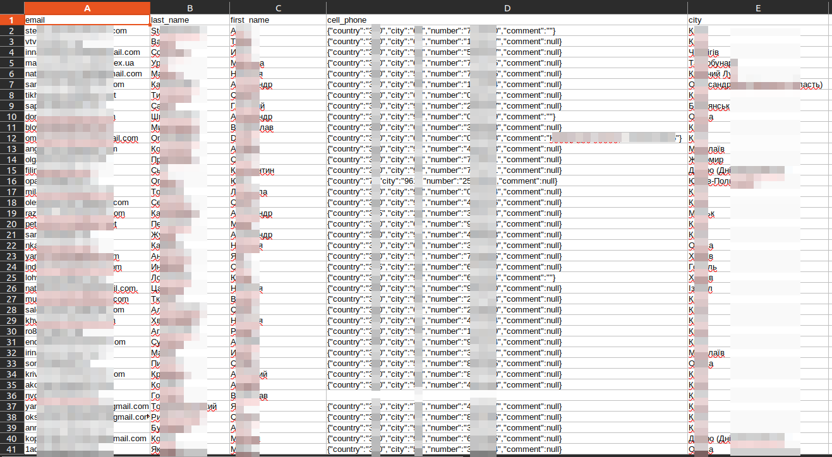
Case Study: Ukrainian PII leak
Ukrainian HR firm GRC.UA
Unauthenticated host exposed over the Internet
More than 1.8 million PII
names, email, phone number, profession, city

Slide 12
Case Study: █████ utility bill payment app
Public Elasticsearch host containing API traffic
Paths, headers, request body, response body, …
Authorization header included JWT
JWT expired after 1-2 months
Account hijacking

Slide 13
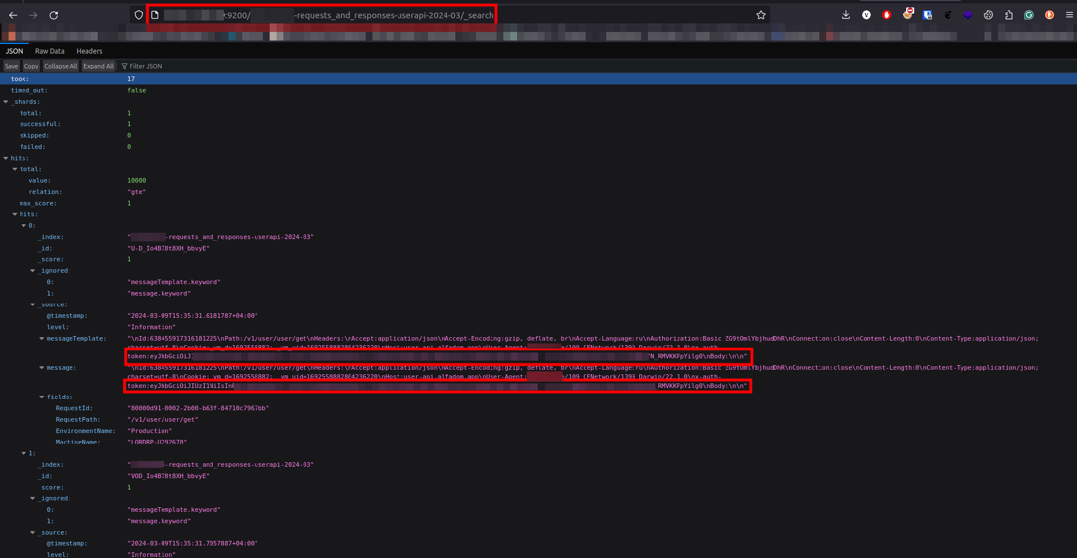
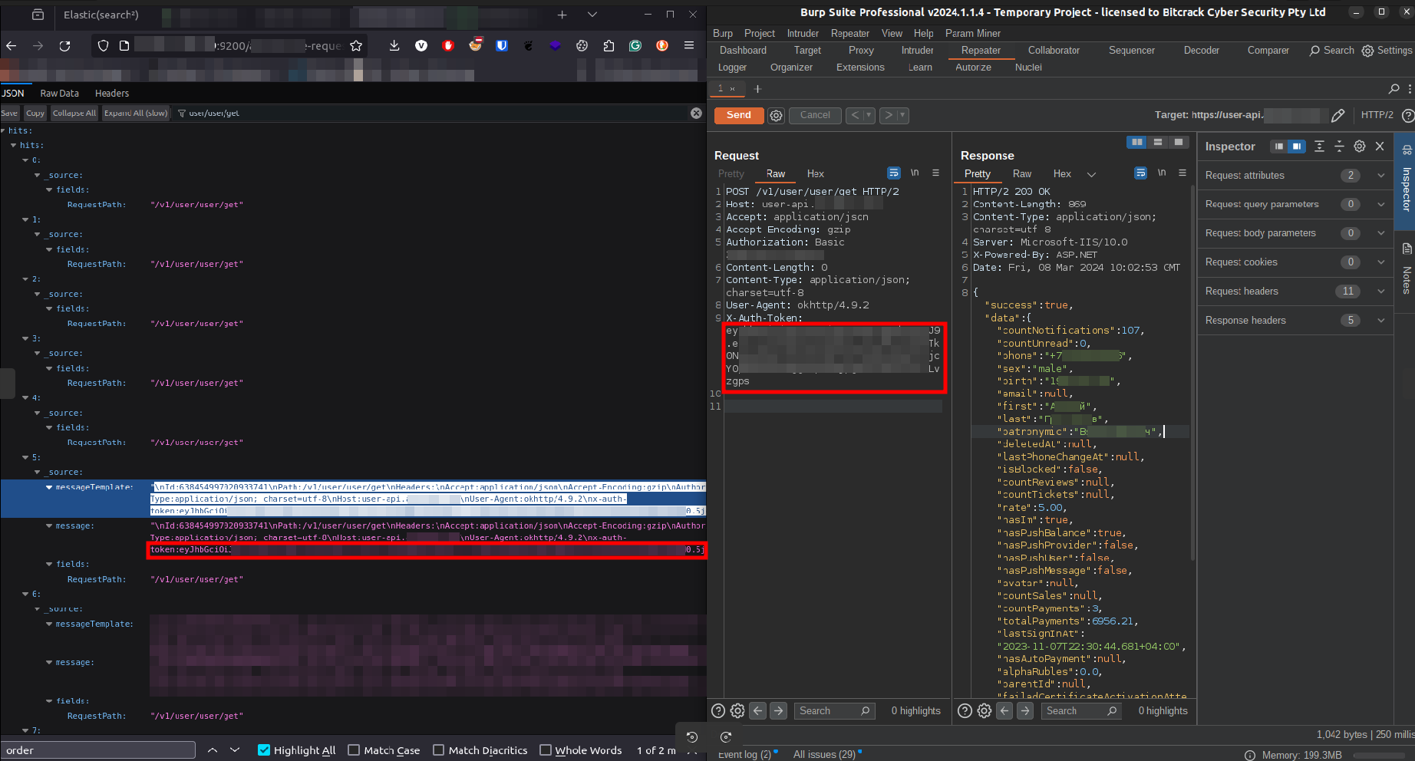

Slide 14
Case Study: █████ utility bill payment app
Deep dive into the application
Login required OTP
OTP brute-forceable
Multiple OTPs valid(?!)
Takeover any account
Around 10K accounts

Slide 15
Statistics
Around 50% of the hosts are in Asia, specifically China, India, and Bangladesh – the rest 50% are from Europe. The US was not covered broadly, yet.
Around 20% of the vulnerable organizations are e-shops containing order tracking details. The remaining 80% vary from governmental bodies to other sorts of companies.
More than 90% of the hosts that belong to governmental bodies are from China. Only one discovered host belonging to a government was not from China but from an Asian SIGINT agency.

Slide 16
Precautions
Measures against it
Asset inventory
Know what you own
Streamline process from creating infrastructure to pushing into production
Regular VAPT
Exposure configuration
Authentication configuration
Credentials
Mutual TLS
Host-based firewalls
Only if Internet exposure is necessary!

